Slide 1
I've Installed WordPress ... Now What?

Slide 2
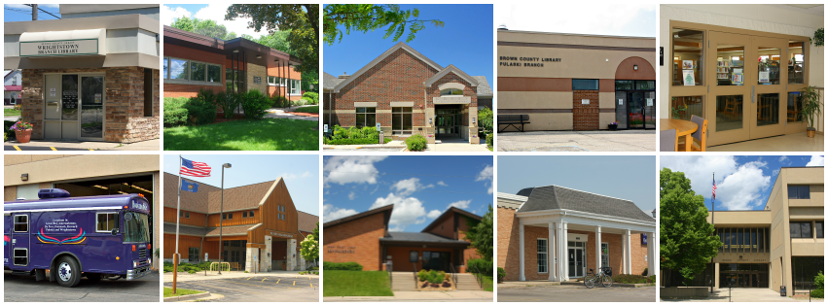
Me and My employer
Francis Beaumier
IT Specialist
Brown County Library, Green Bay, WI
Phone: 920-448-5863
Email: beaumier_fj@co.brown.wi.us
Pronouns: he/him/his

Slide 3
What this presentation is not
A discussion of the pros and cons of WordPress
How to setup a Web site
How to install WordPress
How to write HTML, CSS, and JavaScript
How to be a Webmaster

Slide 4
Where are we going?
Having a look around
Plug-ins
Tweaks

Slide 5
A look Around the Administration Screens
Current area
Main areas
Submenus

Slide 6
A look Around the Administration Screens
Latest news from WordPress / trivia about your site
Double check that you're up-to-date

Slide 7
Pages vs Posts
POSTS:
Time-based, like news items or blog entries
PAGES:
Traditional Web site building blocks. Stuff that will generally stick around (with updates).
How much of either type with depend on how you use your site

Slide 8
A look Around the Administration Screens
Central area for all images and files uploaded to your site
Central area to manage all comments posted

Slide 9
Keeping up appearances
A theme completely changes the look of your site

Slide 10
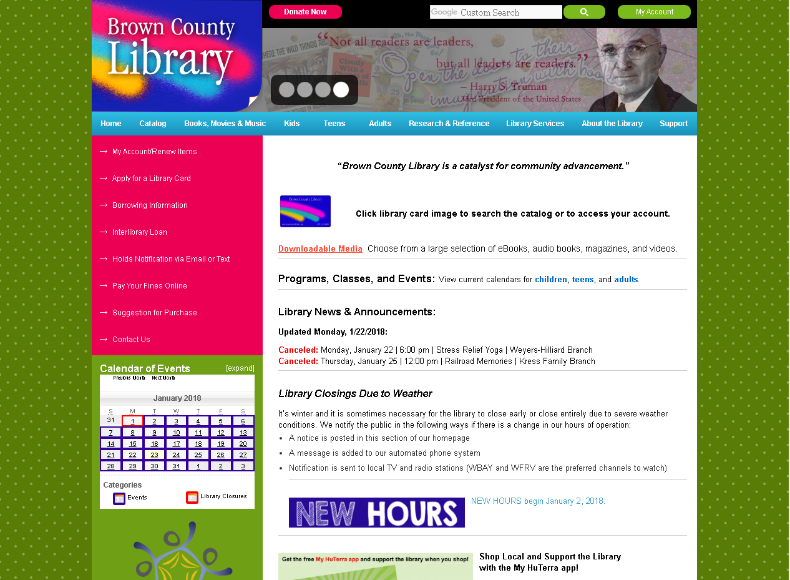
Your Web site can look like this

Slide 11
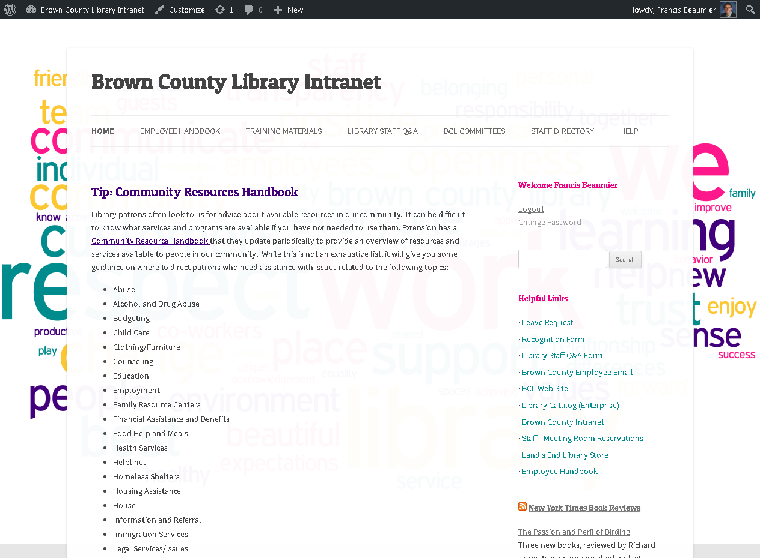
Or this

Slide 12
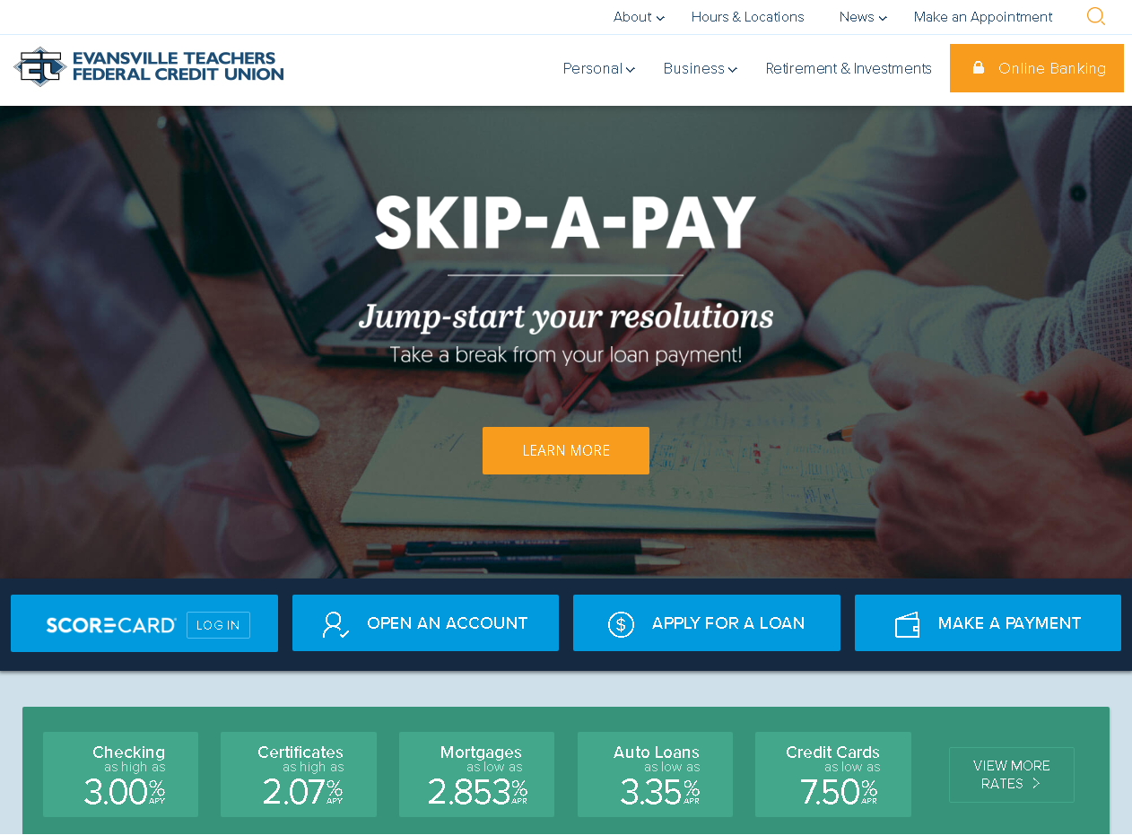
Or this

Slide 13
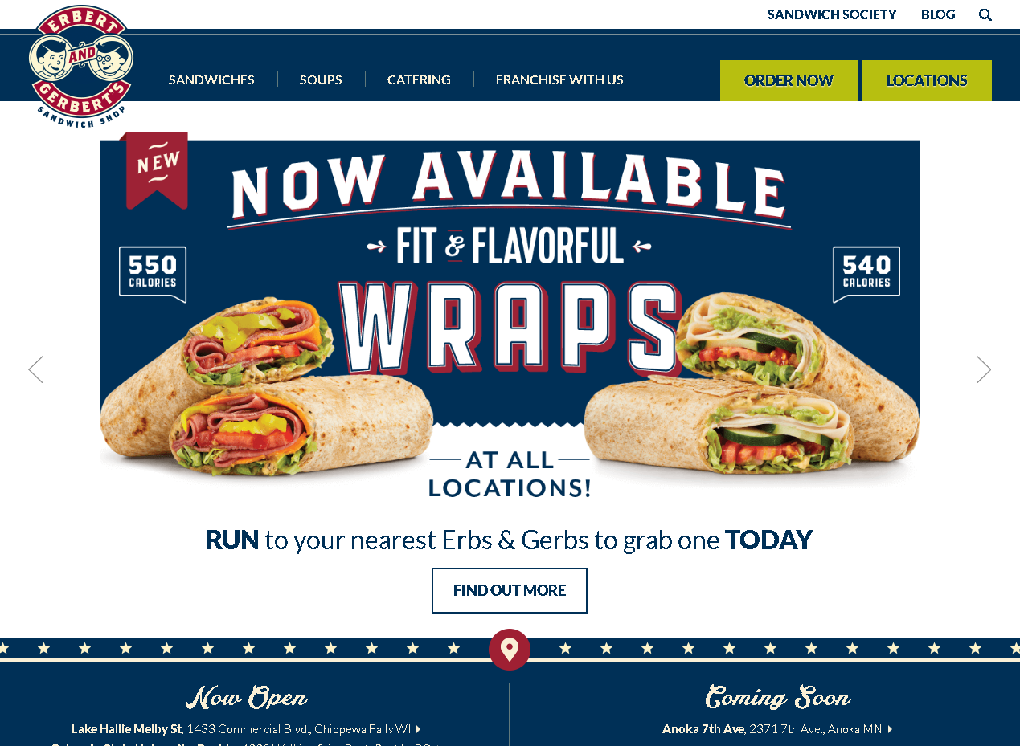
Or this

Slide 14
Keeping up appearances
Text editor for making advanced changes
WordPress GUI for tweaking the current theme

Slide 15
Homework Assignment #1
What do we want our Web site to look like? (Don't forget smartphones and tablets!) How will we get there?
Can we tweak an existing theme?
Should we buy a theme?
Is there someone who can make a derivative (child) theme or a completely new one for us?
How do you tweak a theme? That's coming up in the third half!

Slide 16
What's on the Menu?
Configure navigation for your site
Widgets show up on your Web site's sidebar

Slide 17
DeMO

Slide 18
Homework Assignment #2
Plan your menu(s)
How will your menu be structured?
What goes on the top level?
Will you have it automatically update?

Slide 19
A look Around the Administration Screens
WordPress is designed for collaboration with a variety of users.
Plugins greatly expand what WordPress can do. (MUCH more later!)

Slide 20
Homework Assignment #3
Plan out your user accounts.
How many users will you have?
What will their roles be?
Does it make sense to tie your user accounts with your network accounts?

Slide 21
A look Around the Administration Screens
Download or restore a copy of your posts

Slide 22
Getting all set

Slide 23
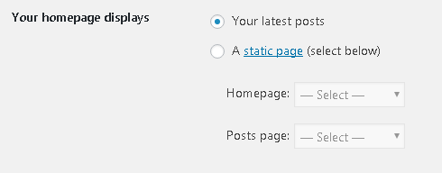
Getting all set

Slide 24
Homework Assignment #4
Will we have a static front page or show the latest posts?
How will incorporate (or not?) posts?

Slide 25
Oh, and there's this toolbar
(it reminds you that you're logged in)
Account settings/sign out
Quickly make a new page/post
Toggle between admin screens and your Web site
Toggle different boxes displayed on each screen

Slide 26
Your turn
What WordPress basics do you wish that someone had told you?
Any Questions so far?

Slide 27
Plug-ins

Slide 28
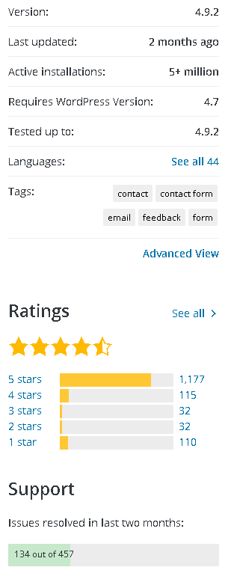
A Mixed Bag
Good
Lots of great features
Bad
No consistency
Could stop working at any time
Neutral
Android Play store vs iOS app store
Best practices
Stick to trusted developers, such as Automattic
Read the reviews
Get an idea of how often the plug-in is being updated
Backups!

Slide 29
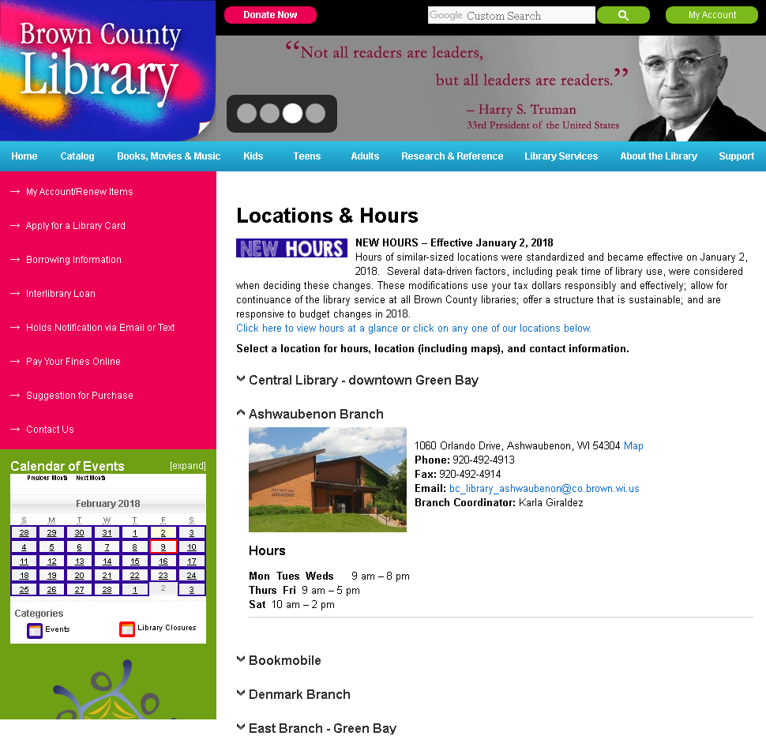
Category: Content Creation
https://wordpress.org/plugins/jquery-collapse-o-matic/

Slide 30
Category: Content Creation
https://wordpress.org/plugins/disabler/

Slide 31
Category: Content Creation
https://wordpress.org/plugins/mce-table-buttons/

Slide 32
Category: Content Creation
https://wordpress.org/plugins/tinymce-advanced/

Slide 33
Category: Content Creation
https://wordpress.org/plugins/wp-simple-anchors-links/

Slide 34
Category: Forms
https://wordpress.org/plugins/contact-form-7/

Slide 35
Category: Forms
https://wordpress.org/plugins/really-simple-captcha/

Slide 36
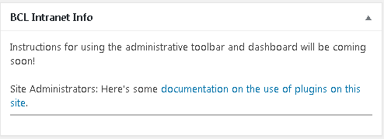
Dashboard Site Notes
Caution: Not recently updated
Category: Intranet
https://wordpress.org/plugins/admin-dashboard-site-notes/

Slide 37
Disable New User Notification Emails
Caution: Not recently updated
Category: Intranet
https://wordpress.org/plugins/disable-new-user-notifications/

Slide 38
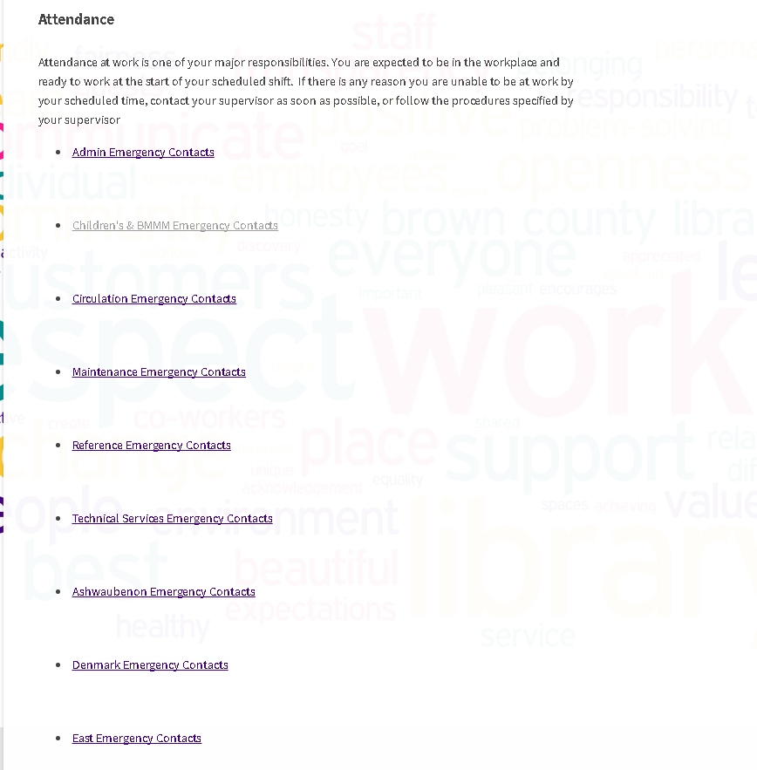
Category: Intranet
https://wordpress.org/plugins/groups/

Slide 39
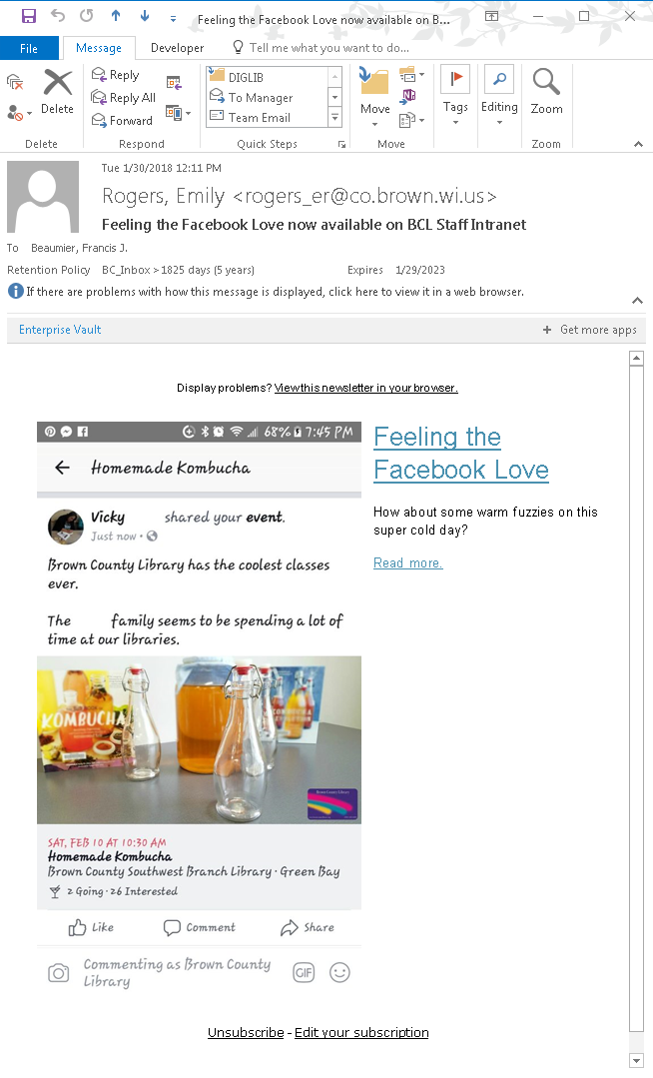
Category: Intranet
https://wordpress.org/plugins/wysija-newsletters/

Slide 40
Category: Intranet
https://wordpress.org/plugins/members/

Slide 41
Category: Intranet
https://wordpress.org/plugins/sidebar-login/

Slide 42
Category: Intranet
https://wordpress.org/plugins/simple-intranet-directory/

Slide 43
Category: Intranet
Caution: Not recently updated
https://wordpress.org/plugins/simple-ldap-login/

Slide 44
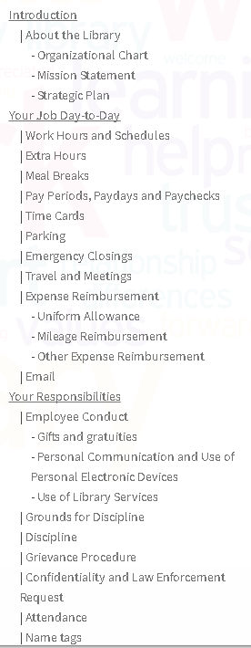
Category: Intranet
Caution: Not recently updated
https://wordpress.org/plugins/table-of-contents-plus/

Slide 45
WP Hide Dashboard
Caution: Not recently updated
Category: Intranet
https://wordpress.org/plugins/wp-hide-dashboard/

Slide 46
GZip Ninja Speed Compression
Caution: Not recently updated
Category: Performance
https://wordpress.org/plugins/gzip-ninja-speed-compression/

Slide 47
Category: Performance
https://wordpress.org/plugins/wp-super-cache/

Slide 48
Category: Security
https://wordpress.org/plugins/akismet/

Slide 49
Category: Security
https://wordpress.org/plugins/hc-custom-wp-admin-url/

Slide 50
Category: Security
https://wordpress.org/plugins/better-wp-security/

Slide 51
Category: SEO
https://wordpress.org/plugins/all-in-one-webmaster/

Slide 52
Category: SEO
https://wordpress.org/plugins/google-sitemap-generator/

Slide 53
Category: Tools
https://wordpress.org/plugins/broken-link-checker/

Slide 54
Category: Tools
https://wordpress.org/plugins/username-changer/

Slide 55
Category: Tools
https://wordpress.org/plugins/wp-clone-by-wp-academy/

Slide 56
Category: Widgets
https://wordpress.org/plugins/my-calendar/

Slide 57
Category: Widgets
https://wordpress.org/plugins/rss-feed-widget/

Slide 58
Category: Misc
https://wordpress.org/plugins/book-a-room/

Slide 59
Category: Misc
https://wordpress.org/plugins/wp-mail-smtp/

Slide 60
Homework Assignment #5
Now you have an idea of what WordPress can do and what plug-ins can do.
What features do you want your Web site to have?
Can you use a plug-in to get you there?

Slide 61
Your turn
What are some awesome plug-ins?
What are your plug-in best practices?
Any questions so far?

Slide 62
Tweaks

Slide 63
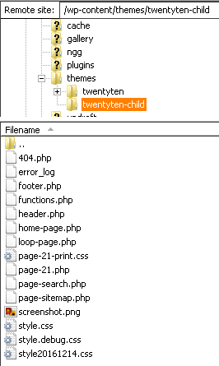
Customize a Theme
Never modify a theme directly – create a child theme instead!
style.css is required – a comment at the top doubles as the info WordPress needs to name the theme and associate it with the parent.
These days, functions.php is also needed, as there a particular way WordPress wants you to wire up the CSS.
Custom 404 page
Other files override the equivalently named file in the parent theme.
https://codex.wordpress.org/Child_Themes https://developer.wordpress.org/themes/

Slide 64
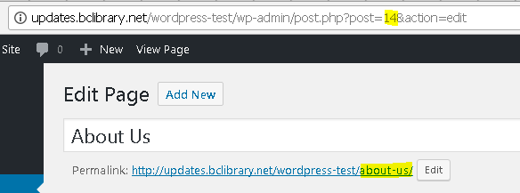
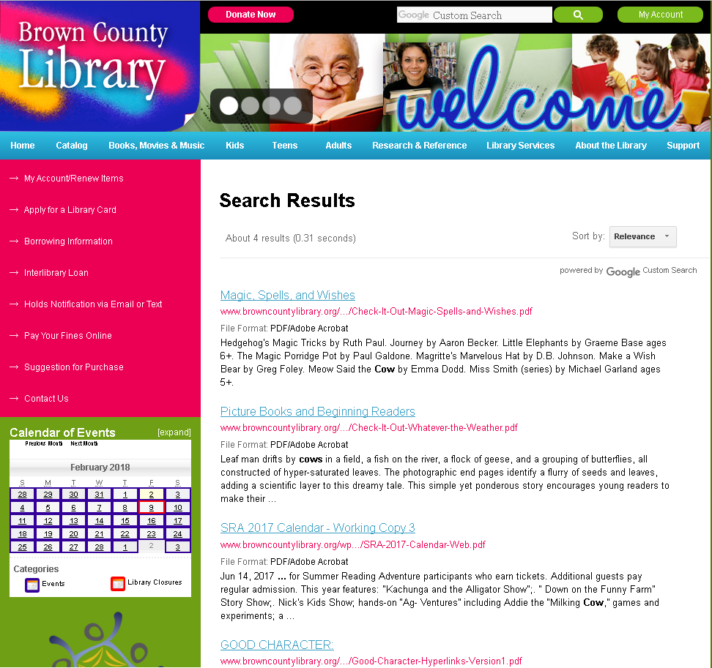
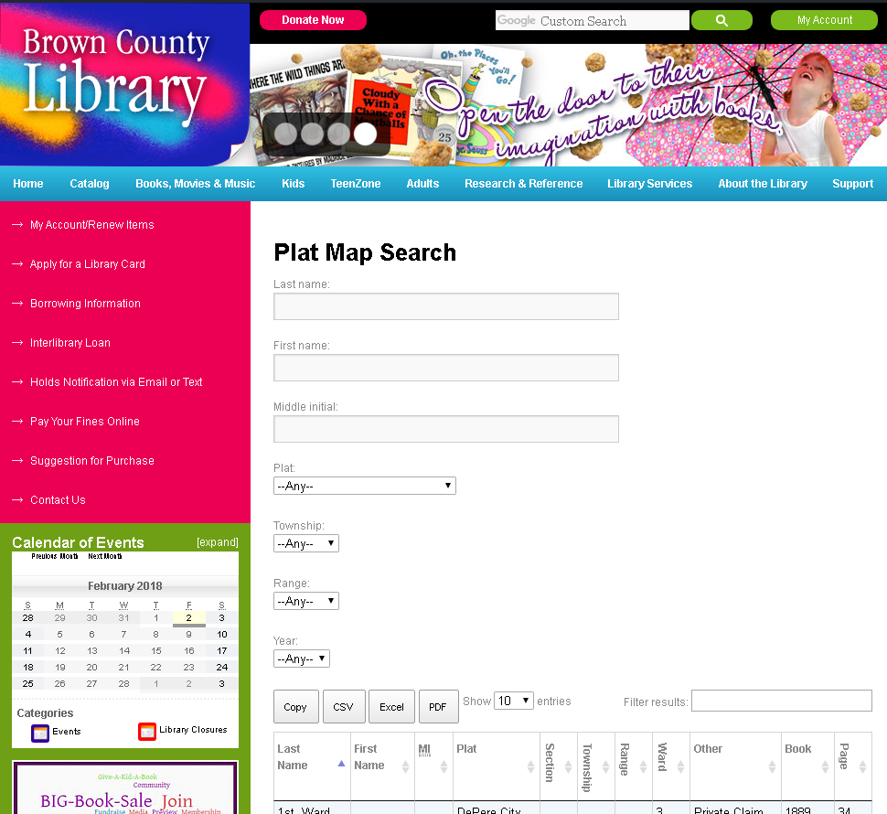
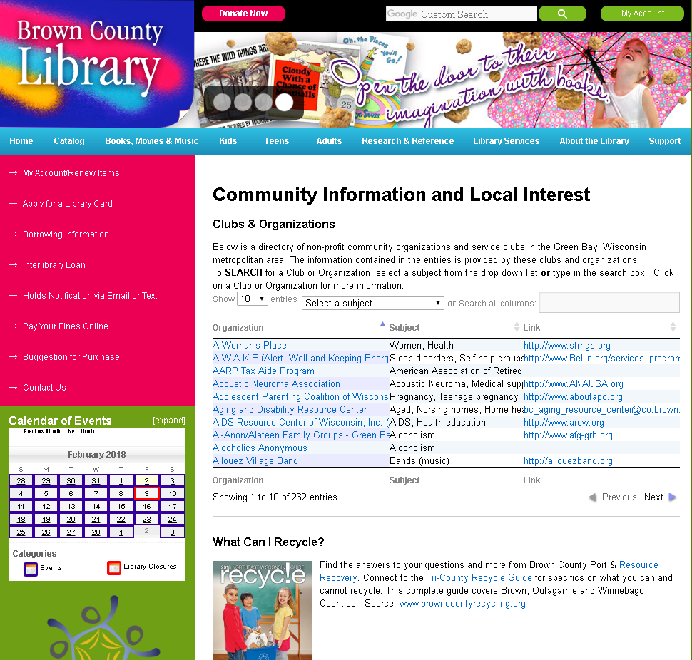
Customize a Page

Slide 65
Make a Plug-In
function brown_staffdirectory_shortcode( $atts ) {
$html = '';
$user_query = new WP_User_Query(array('meta_query'=>array('key'=>'department','value'=>$atts[dept],'compare'=> 'LIKE' ),
'orderby' => 'meta_value', 'meta_key' => 'last_name'));
foreach ( $user_query->results as $author ) {
$userBio = get_the_author_meta('url', $author->ID);
$userAvatar = get_avatar($author->ID);
$userEmail = get_the_author_meta('email', $author->ID);
$userDept = get_the_author_meta('department', $author->ID);
$userTitle = get_the_author_meta('title', $author->ID);
$userPhone = get_the_author_meta('phoneext', $author->ID);
if ( $userBio != '' ) {
$html .= "<div class=\"employeephoto\"><a href=\"$userBio\">$userAvatar</a></div><div class=\"employeebio\">"
. "<strong><a href=\"$userBio\">{$author->display_name}</a></strong> <small><a href=\"$userBio\">"
. "[more info]</a></small>";
}
else {
$html .= "<div class=\"employeephoto\">$userAvatar</div><div class=\"employeebio\"><strong>"
. "{$author->display_name}</strong>";
}
$html .= "<br><a href=\"mailto:$userEmail\">$userEmail</a><br>$userDept — "
. "<em>$userTitle</em><br>$userPhone<br><br></div>";
}
return $html;
}
// hooks and filters
add_shortcode( 'staffdirectory', 'brown_staffdirectory_shortcode' ); // create shortcode

Slide 66
Your turn
What Tweaks Have you Done?
Any WordPress knowledge you'd like to impart?
Any final questions?

Slide 67
Homework Assignment #6
Send me your Web site!
Show me how you've customized WordPress!
Inspire all of us!

Slide 68
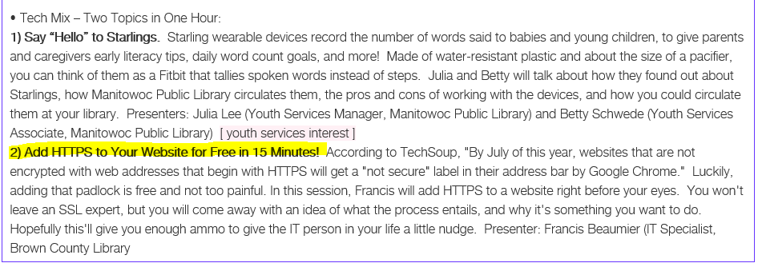
Shameless self-promotion

Slide 69
Thank you!
Francis Beaumier
IT Specialist
Brown County Library, Green Bay, WI
Phone: 920-448-5863
Email: beaumier_fj@co.brown.wi.us
Pronouns: he/him/his

